Slide 1
Lecture 03: Memory and I/O Modules

Slide 2
William Stallings Computer Organization and Architecture
Chapter 5
Internal Memory

Slide 3
Key Content
Memory taxonomy & characteristics
Physical type, location, capacity, unit of transfer, access method, performance
Memory hierarchy in computer system
Registers -> Cache -> Main memory -> Disk
RAM organization (SRAM and DRAM)
Cell -> Array -> Chip
Memory module extension
Bit & word extension

Slide 4
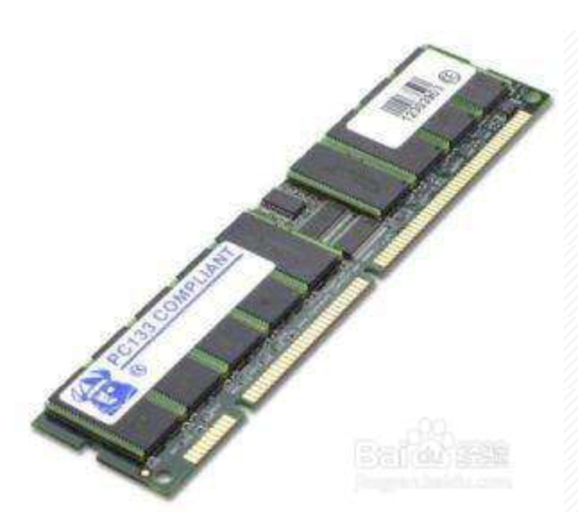
Physical Types of Memory
Semiconductor
RAM & ROM
Magnetic
Disk & Tape
Optical
CD & DVD

Slide 5
Memory Characteristics Comparison
Location
Capacity
Unit of transfer
Access method
Performance
Physical type
Organisation

Slide 6
Location
CPU
registers
Internal
Cache, main memory
External
Disk, tape, DVD

Slide 7
Capacity
Word size
The natural unit of organization
Number of words
E.g., 2M 8-bit, 16M 1-bit
Same capacity but different organization

Slide 8
Unit of Transfer
Internal
Usually a word, governed by data bus width
External
Usually a block which is much larger than a word
E.g., the CPU can calculate one addition every cycle, but a memory transfer takes two cycles. With the memory interface width to be 4 words, the CPU can be kept with 100% utilization.

Slide 9
Addressable unit
Smallest location which can be uniquely addressed
Normally a Byte for internal memory
Cluster on disks

Slide 10
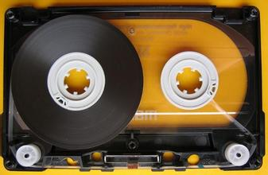
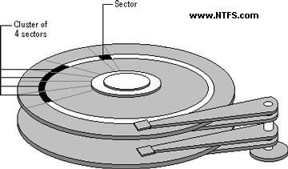
Access Methods (1)
Sequential
Start at the beginning and read through in order
Access time depends on location of data and previous location
e.g. tape
Direct
Individual blocks have unique address
Access is by jumping to vicinity plus sequential search
Access time depends on location and previous location
e.g. disk

Slide 11
Access Methods (2)
Random
Individual addresses identify locations exactly
Access time is independent of location or previous access
e.g. RAM, ROM
Associative
Data is located based on a portion of its contents rather than its address
Access time is independent of location or previous access
e.g. cache

Slide 12
Performance
Access time: time between presenting the address and getting the valid data
Memory cycle time: time may be required for the memory to “recover” before next access
Cycle time is access + recovery
Transfer rate: rate at which data can be moved
Unit: transfer per second (e.g., GT/s)
Transfer bandwidth
Equals Transfer rate * Transfer unit size
Unit: byte per second (e.g., GB/s)

Slide 13
Quiz
Determine the access time, transfer rate, and transfer bandwidth for the following memory
A memory transfer takes two cycles, and each transfer has 4 bytes
Clock frequency is 1 GHz

Slide 14
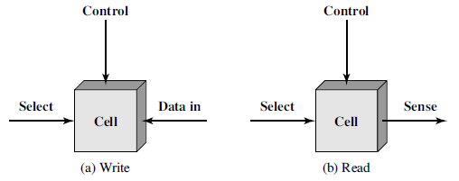
Semiconductor Memory
The basic element of a semiconductor memory is the memory cell
exhibit two stable states, representing binary 1 and 0
capable of being written into to set the state
capable of being read from to sense the state
RAM (Random Access Memory)
Misnamed as all semiconductor memory is random access
ROM (Read-Only Memory)

Slide 15
Memory Basics
RAM: Random Access Memory
historically defined as memory array with individual bit access
Refers to memory with both Read and Write capabilities
ROM: Read Only Memory
No capabilities for “online” memory Write operations
Write typically requires high voltages or erasing by UVlight

Slide 16
Memory Basics
Volatility of Memory
Volatile memory loses data over time or when power is removed RAM is volatile
non-volatile memory stores date even when power is removed
ROM is non-volatile
Static vs. Dynamic Memory
Static: holds data as long as power is applied (SRAM)
Dynamic: will lose data unless refreshed periodically (DRAM)

Slide 17
Random Access Memory (RAM)
Read/Write
Volatile
must be provided with a constant power supply
Temporary storage
When the power is gone, data are lost
Static or dynamic
SRAM or DRAM

Slide 18
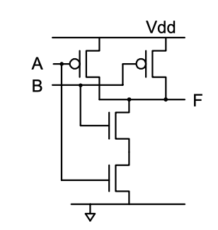
Recap on Digital Circuit
Field effect transistor (FET)
pFET vs nFET
CMOS gate:
Complementary metal–oxide–semiconductor
Quiz: what is this gate for?

Slide 19
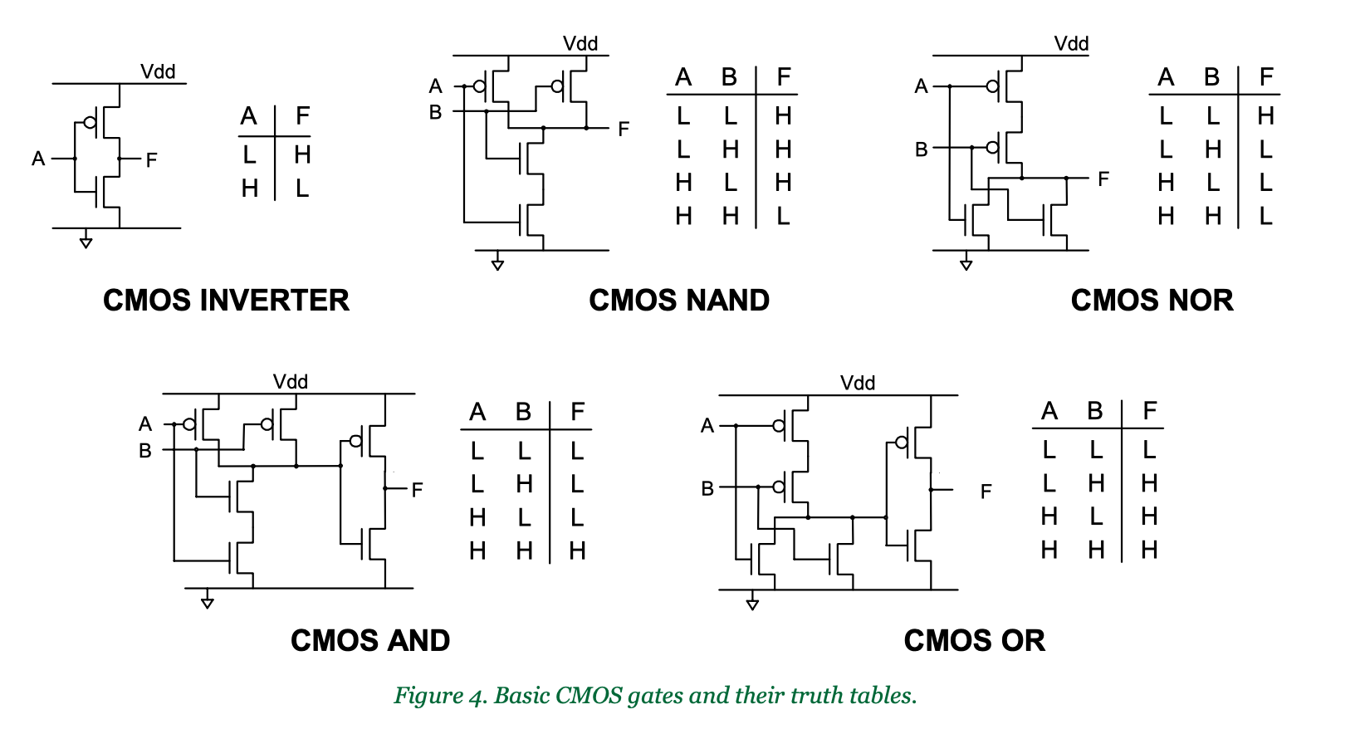
Quiz: can you identify those gates?

Slide 20
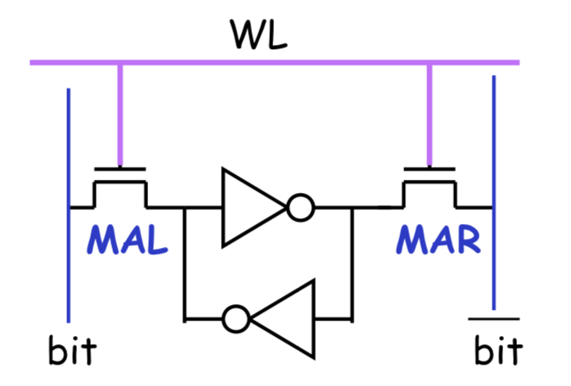
Static RAM
Bits stored as on/off switches
No charges to leak
No refreshing needed when powered
More complex construction
Larger per bit
More expensive
Does not need refresh circuits
Faster
For the use of register & cache
traditional flip-flop logic-gate configurations

Slide 21
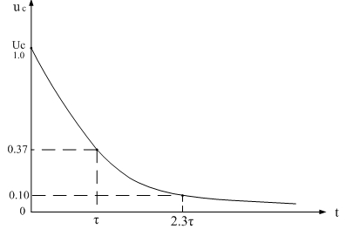
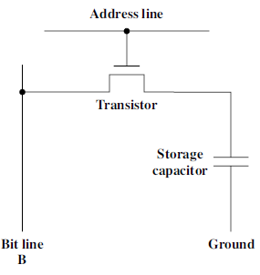
Dynamic RAM
Bits stored as charge in capacitors
Charges leak
Need refreshing even when powered
Simpler construction
Smaller per bit
Less expensive
Need refresh circuits
Slower
For the user of main memory

Slide 22
Key Content
Memory taxonomy & characteristics
Physical type, location, capacity, unit of transfer, access method, performance
Memory hierarchy in computer system
Registers -> Cache -> Main memory -> Disk
RAM organization (SRAM and DRAM)
Cell -> Array -> Chip
Memory module extension
Bit & word extension

Slide 23
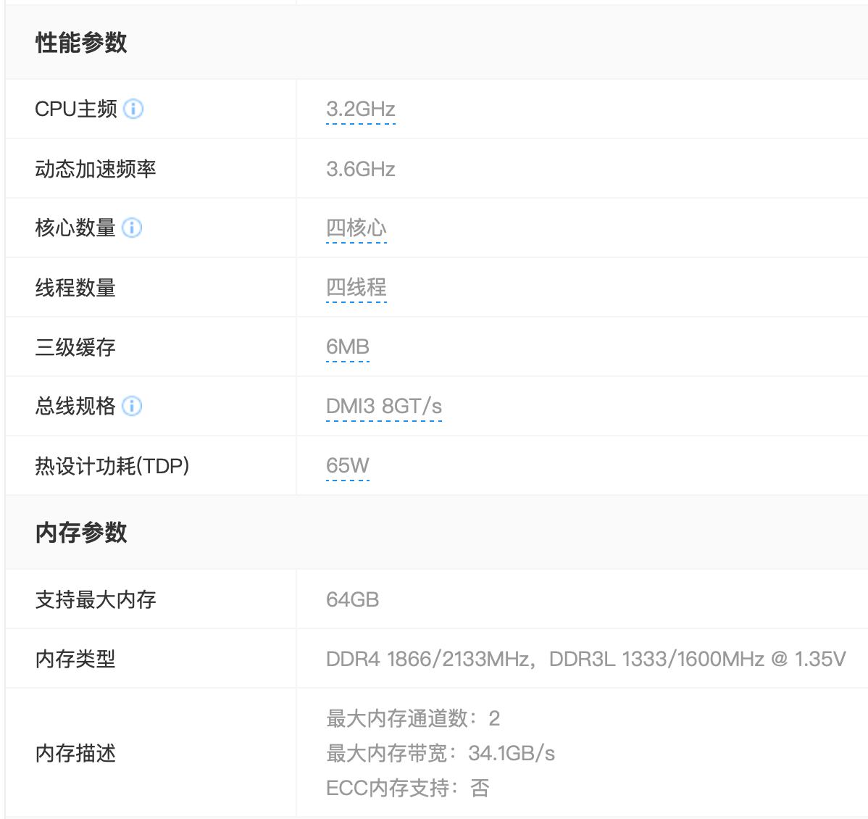
Memory is Organized with Hierachy
Registers
L1 Cache
L2 Cache
Main memory
Disk cache
Disk
Optical
Tape

Slide 24
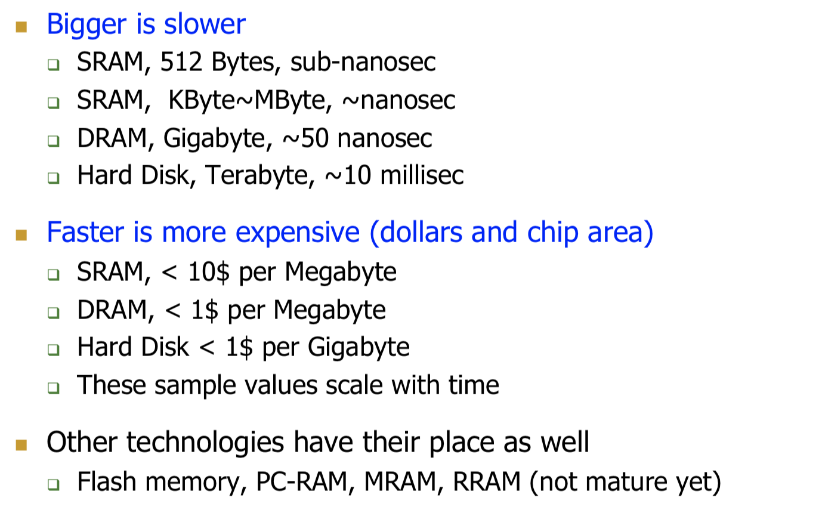
Why Memory Hierarchy

Slide 25
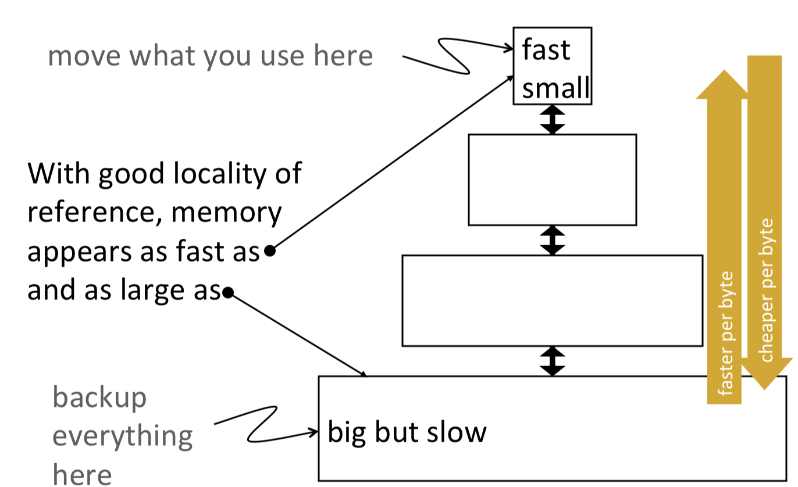
Idea Behind Memory Hierarchy

Slide 26
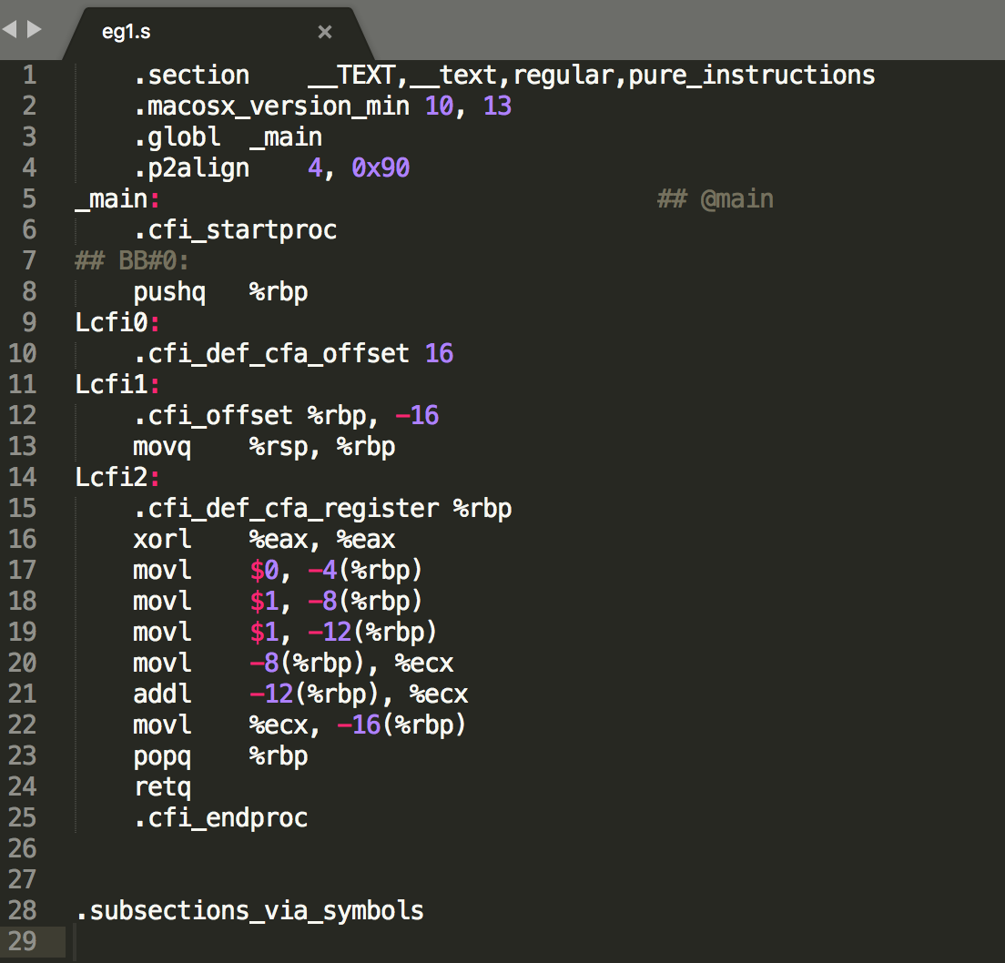
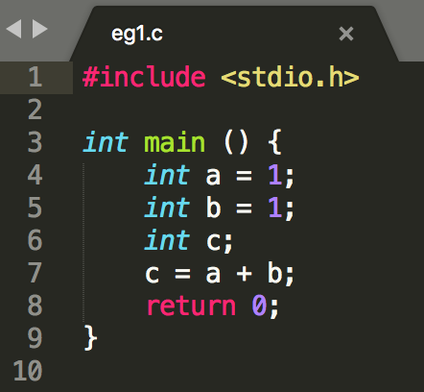
Example
C code

Slide 27
Key Content
Memory taxonomy & characteristics
Physical type, location, capacity, unit of transfer, access method, performance
Memory hierarchy in computer system
Registers -> Cache -> Main memory -> Disk
RAM organization (SRAM and DRAM)
Cell -> Array -> Chip
Memory module extension
Bit & word extension

Slide 28
Memory Interface with CPU
内存 Memory (1KB)
字 word (16/32/64比特)
AX + BX -> addr0
地址 0
1
AX
下条指令
CU 控制单元
BX
2
CX
3
DX
4
AX
BX
5
ALU 运算单元
addr0
…
…
0x3FF (1023)
字节 Byte (8 bit比特)

Slide 29
Memory Interface with CPU
内存 Memory (1KB)
地址 0
数据 data
 | 1K x 8 | 2K x 4 | 8K x 1
Memory Capacity | 1 KB | 1 KB | 1 KB
Data Bus Width | 8 | 4 | 1
Addr Bus Width | 10 | 11 | 13
1
2
3
4
5
地址 address
…
…
0x3FF (1023)
字节 Byte (8 bit比特)

Slide 30
Memory Interface with CPU
内存 Memory (1KB)
地址 0
数据 data
 | 1K x 8 | 2K x 4 | 8K x 1
Memory Capacity | 1 KB | 1 KB | 1 KB
Data Bus Width | 8 | 4 | 1
Addr Bus Width | 10 | 11 | 13
1
2
3
4
5
地址 address
…
…
0x3FF (1023)
字节 Byte (8 bit比特)

Slide 31
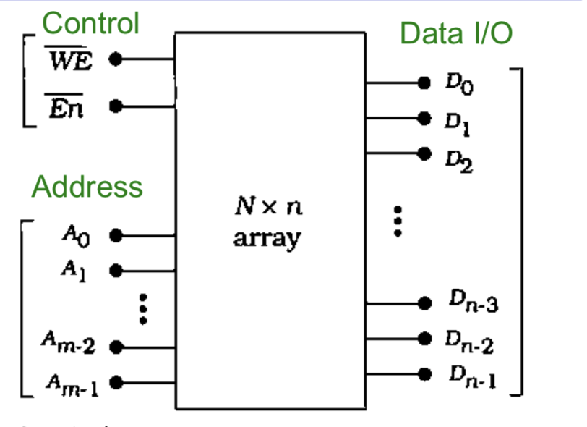
Memory Chip
N x n memory chip
n = chip word width (note that this “word” is chip word not CPU word)
N = number of n-bit words
Chip I/O
Data (in and out): Dn-1 – D0
Address: Am-1 – A0
Control
WE = write enable (assert low)
WE=1: read, WE=0: write
En block enable (assert low)

Slide 32
Memory Chip (Logical View)
Example: 4M x 4 RAM (16-Mbit RAM chip)
2²² = 4 M (4x1024x1024) word
Each word has 4 bits
22 address lines (reduced to 11 if multiplexed)
4 data lines

Slide 33
Memory Chip (Physical View)
Example: 4M x 4 RAM (16-Mbit RAM chip)
A 16Mbit chip has 16M SRAM cells
But how are they organized?
Is this
4M x 4 array
a good organization?

Slide 34
Memory Array
N_{R} x N_{C} array of 1-bit cells
N_{R} = number of rows
N_{C} = number of columns

Slide 35
Memory Chip (Physical View)
A 16Mbit chip can be organised as 1M of 16-bit words
A 16Mbit chip can be organised as a 2048 x 2048 x 4bit array
Reduces number of address pins
Multiplex row address and column address
11 pins to address (2¹¹=2048)
Adding one more pin doubles range of values so x4 capacity

Slide 36
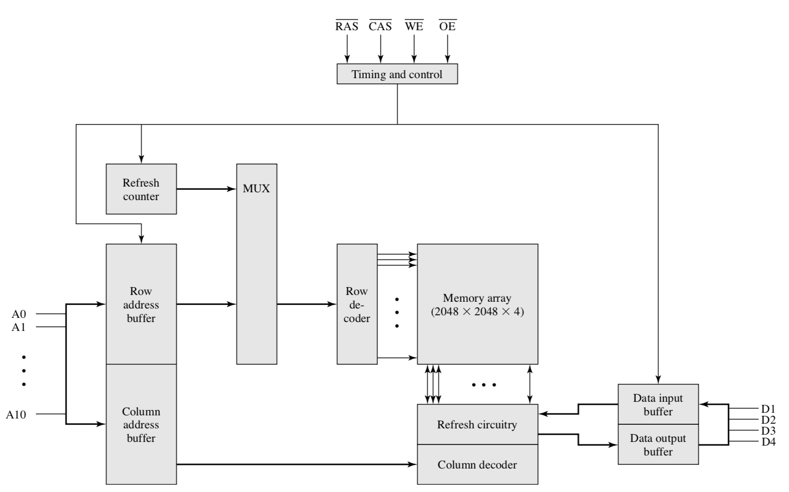
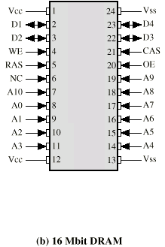
Typical 16 Mb RAM (4M x 4)
The 4M x 4 RAM is organized as four 2048 x 2048 array

Slide 37
How to Access Memory Array

Slide 38
How to Access Memory Array
Example of 4 x 1 array
Example of 16 x 1 array

Slide 39
How to Access Memory Array
Example of 4 x 1 array
Example of 16 x 1 array

Slide 40
Key Takeaway in This Part
Understand the logical interface for a memory chip
Understand the internal organization of the chip

Slide 41
Key Content
Memory taxonomy & characteristics
Physical type, location, capacity, unit of transfer, access method, performance
RAM organization (SRAM and DRAM)
Cell -> Array -> Chip
Memory hierarchy in computer system
Registers -> Cache -> Main memory -> Disk
Memory module extension
Bit & word extension

Slide 42
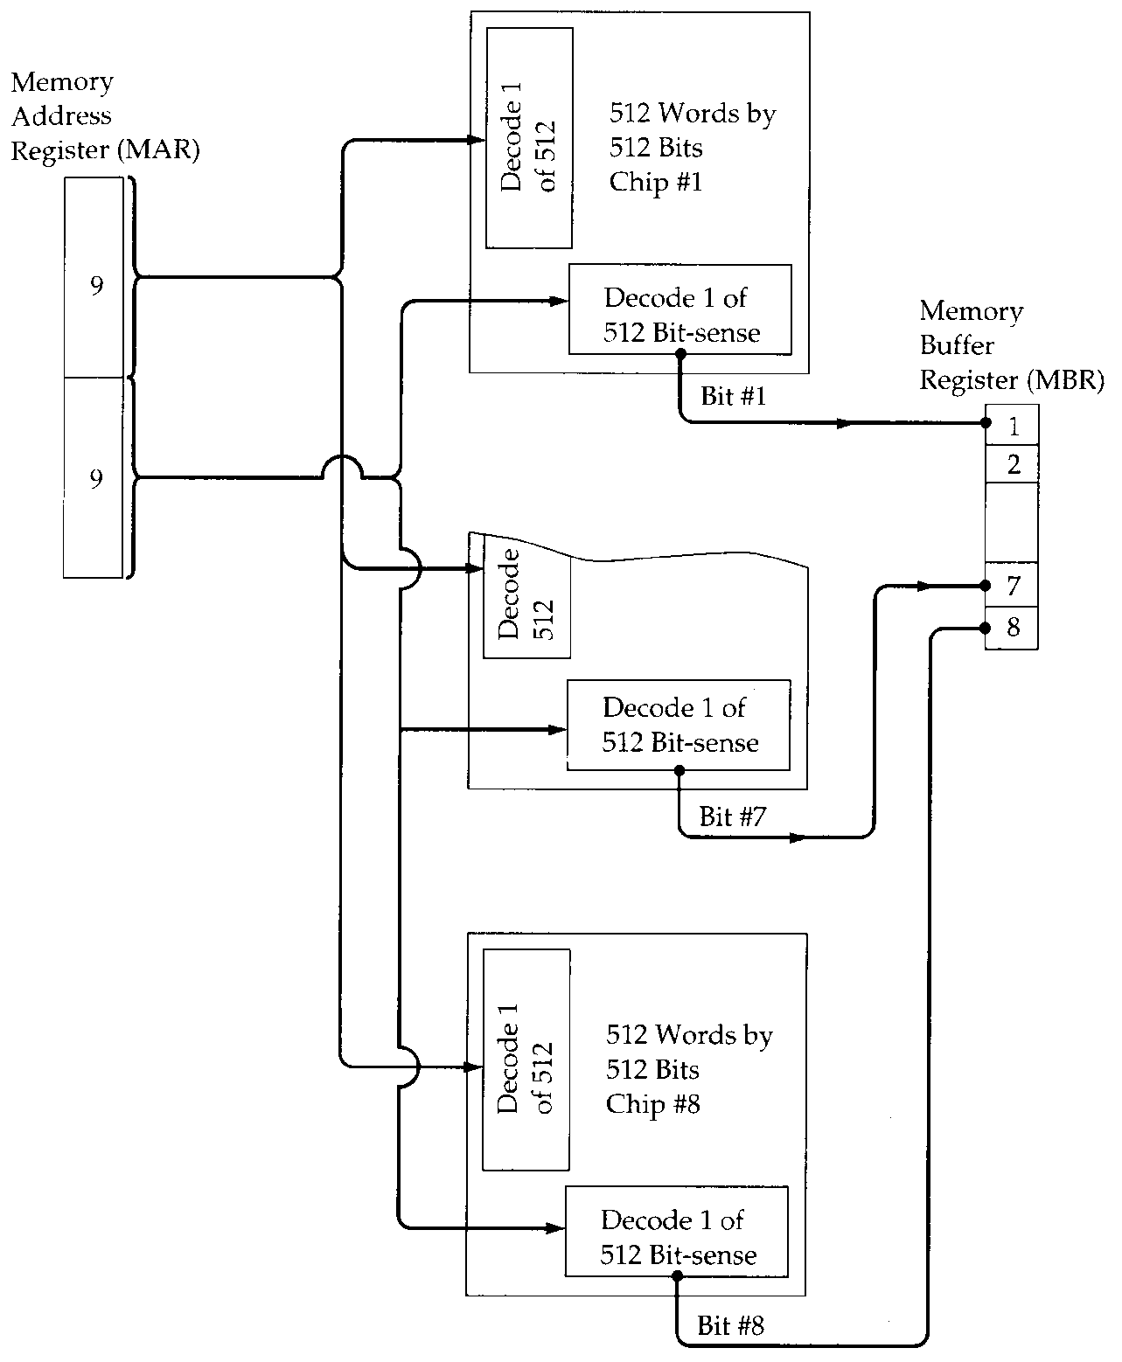
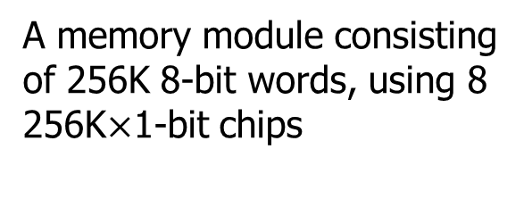
Module Organisation
A memory module consisting of 256K 8-bit words, using 8 256K$×$1-bit chips
To organize a memory module：
If the module needs bigger unit of transfer than that of given memory chips, bit extension
Every chip has the same address space

Slide 43
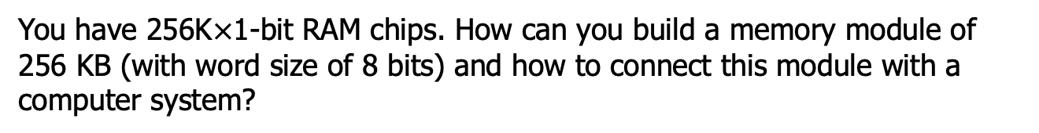
Bit Extension Example
You have 256K$×$1-bit RAM chips. How can you build a memory module of 256 KB (with word size of 8 bits) and how to connect this module with a computer system?
A₁₇₋₀
A₁₇~A₀
D₇
D₇~D₀

Slide 44
Bit Extension Example
You have 256K$×$1-bit RAM chips. How can you build a memory module of 256K$×$32-bit and how to connect this module with a computer system?
What if the addressable unit is byte?
A₁₇₋₀
A₁₇₋₀

Slide 45
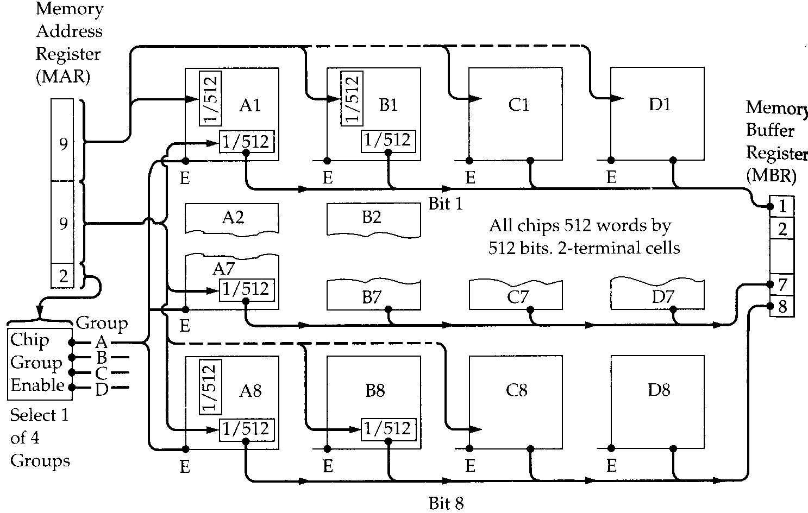
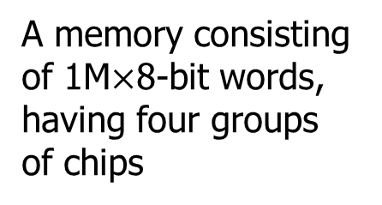
Module Organisation (2)
A memory consisting of 1M$×$8-bit words, having four groups of chips
To organize a memory module：
If the module needs larger number of words than that of given memory chips, word extension
Chips in different group has different address range

Slide 46
Word Extension Example
You have 256K$×$8-bit RAM chips. How can you build a memory module of 2M$×$8-bit and how to connect this module with a computer system?

Slide 47
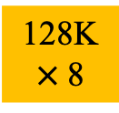

Quiz
You have 128K$×$8-bit RAM chips. How can you build a memory module of 128K$×$16-bit and how to connect this module with a computer system?
A₁₇~A₀
A₁₇₋₁
A₁₇₋₁
128K
$×$8
128K
$×$8
D₁₅~D₈
D₇~D₀
D₇
D₁₅~D₀

Slide 48
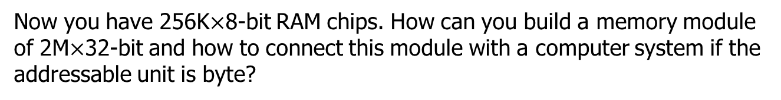
Word and Bit Extension Example
Now you have 256K$×$8-bit RAM chips. How can you build a memory module of 2M$×$32-bit and how to connect this module with a computer system if the addressable unit is byte?

Slide 49
Memory Module Extension Summary
Control
Addr
Data
CPU Word
The size of instruction operand 一条指令中数据的宽度
Add AX, BX, CX (Size of register AX/BX/CX)
CPU addressable unit
The size of data represented by an address
Usually one byte (8 bits)
Interface
Address bus width
Data bus width
Memory chip N x n
n: size of memory word
N: number of words
Notes:
接口

Slide 50
Memory Module Extension Summary
When to use word/bit extension
CPU wants the memory module of N_{CPU} x n_{CPU}
Memory chip has N_{mem} x n_{mem}
Word extension: N_{CPU} > N_{mem}
Connect data bus of CPU and all memory chips directly
Requires extra decoder for address bus connection
Bit extension : n_{CPU} > n_{mem}
Connect address bus of CPU and all memory chips directly
May discard some address lines when n_{CPU} > CPU addressable unit
Assemble memory chips’ data buses to connect with CPU

Slide 51
Quiz
For a 1MB memory module
If addressable unit equals 8，What’s the address range
If addressable unit equals 32，What’s the address range
If we have 256K x 4bit memory chip
If data bus width = 8，how do we extend?
If data bus width = 32，how do we extend?
0x00000-
0xFFFFF
0x00000-
0x3FFFF
CPU wants 1M x 8:
(1M/256K)x(8/4)=4x2
4 times word extension and 2 times bit extension
CPU wants 256K x 32: (256K/256K)x(32/4)=1x8
8 times bit extension
(need to discard address A₀-A₁lines)

Slide 52
Read Only Memory (ROM)
Permanent storage
Nonvolatile
Needs no power
Normal applications of ROM (Firmware)
Library subroutines
Systems programs (BIOS)
Function tables

Slide 53
Types of ROM
Written during manufacture
Very expensive for small runs
Programmable (once)
PROM
Needs special equipment to program
Read “mostly”
Erasable Programmable (EPROM)
Erased by Ultraviolet radiation
Electrically Erasable (EEPROM)
Takes much longer to write than read
Flash memory
Erase whole memory electrically

Slide 54
Key Content Review
Memory taxonomy & characteristics
Physical type, location, capacity, unit of transfer, access method, performance
RAM organization (SRAM and DRAM)
Cell -> Array -> Chip
Memory hierarchy in computer system
Register -> cache -> main memory -> disk
Memory module extension
Bit & word extension

Slide 55
So you want fast?
It is possible to build a computer which uses only static RAM (cache)
This would be very fast
This would need no cache
How can you cache cache?
This would cost a very large amount
Trade-offs among speed, capacity, and cost

Slide 56
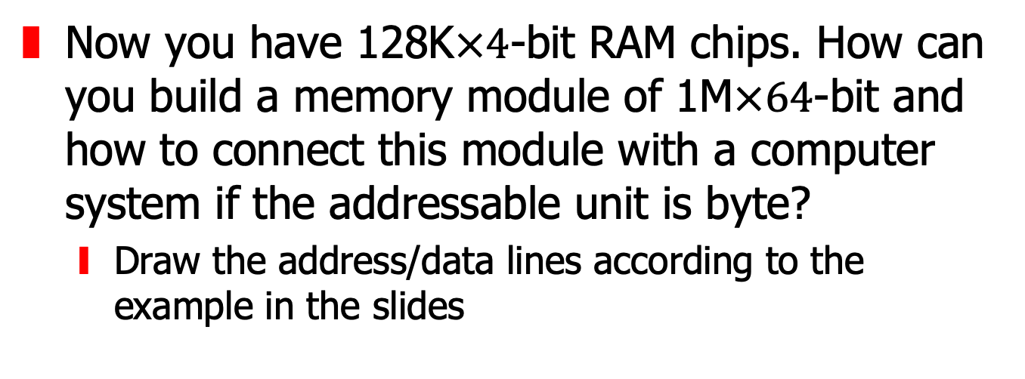
Assignment Two
Now you have 128K$×4$-bit RAM chips. How can you build a memory module of 1M$×64$-bit and how to connect this module with a computer system if the addressable unit is byte?
Draw the address/data lines according to the example in the slides

